Slide 1
POWER SYSTEM MANAGEMENT
Muhammad Nazhan Bin Ramli
1816847

Slide 2
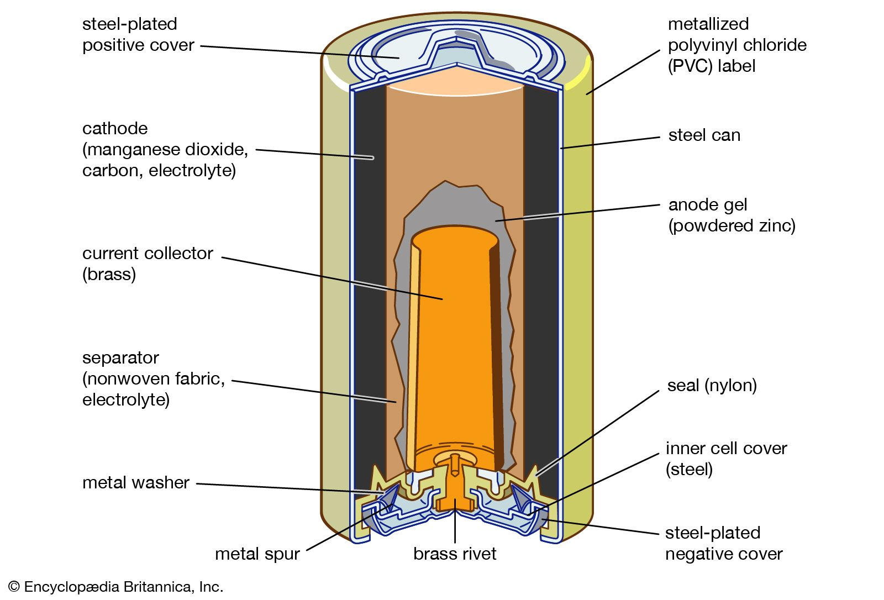
Battery and how does it work?
A battery is a collection of one or more cells, storing electrical energy for powering electrical devices.
Chemical reactions create the flow of electrons within a circuit. The stored chemical energy is then converted into direct current electric energy.

Slide 3
Types of batteries
Primary Batteries (non-rechargeable)
A primary battery is a convenient sources of power for portable electronics and devices. This includes radios, watches, toys, lights, camera, and more.
Since they can’t be recharged once they run out of power, they’re the type to “discard immediately when discharged”. In short, they can’t be used again.
Primary batteries are inexpensive, lightweight, and convenient to use with no maintenance. The majority used in domestic applications are single cell type.
They usually come in a cylindrical form, such as Alkaline batteries. They got their name from the electrolyte used in them: potassium hydroxide—a pure alkaline substance.
This type of primary battery is a chemical composed of zinc (Zn) and manganese dioxide (MnO2). It has a power density of 100 Wh/kg.
Other shapes and sizes of a primary battery include a coin-shaped one, a.k.a. coin cell batteries. They are often used in torches, remotes, wall clocks, small portable gadgets, and more.

Slide 4
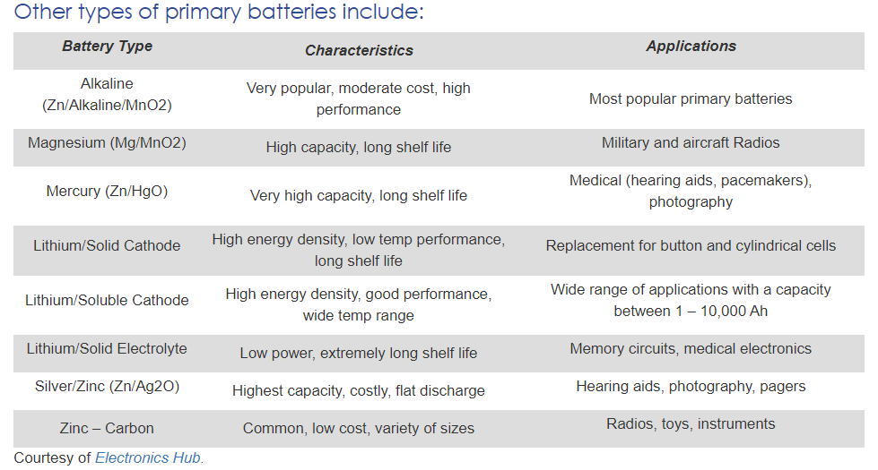

Slide 5
2) Secondaries batteries (rechargeable)
The main advantage of these batteries is they can be recharged and reused. Hence the other term: rechargeable batteries.
Secondary batteries usually cost more than primary ones. But considering they’re rechargeable, they can have a longer lifespan.
Used for 2 applications :
Energy storage devices
Uninterrupted Power Supplies (UPS) – a battery backup for computers.
Hybrid Electric Vehicles (HEV)
Applications where the battery is used and discharged as a primary battery
Mobiles
Laptops
Electric vehicles
Once they’re completely or almost discharged, they can be recharged with a charging mechanism.
For example, smartphone batteries. Most models have a lithium-ion battery that lives longer when charged often.
This type of battery acts as their main power source, their primary one. But unlike the standard primary batteries, lithium-ion is rechargeable and reusable.
For one, instead of discarding it, you pull out your cable wire or charger then plug it into a socket to charge it.

Slide 6
Other major types of rechargeable batteries
Nickel – Cadmium Batteries. One of the oldest battery types available today. They have a very long life and are also very reliable and sturdy.
Nickel – Metal Hydride Batteries. They’re a new type of battery, an extended version of Nickel – Hydrogen Electrode Batteries. Ideal use in aerospace applications (satellites).

Slide 7
Battery applications
Portable electronic devices: Smartphones, watches, cameras, laptops, calculators, including testing equipment like multimeters.
Entertainment: Radios, MP3 and CD players, infrared remote controls, toys and games, etc.
Household: Smoke detectors, alarms, clocks, UPS, portable power tools, and more.

Slide 8
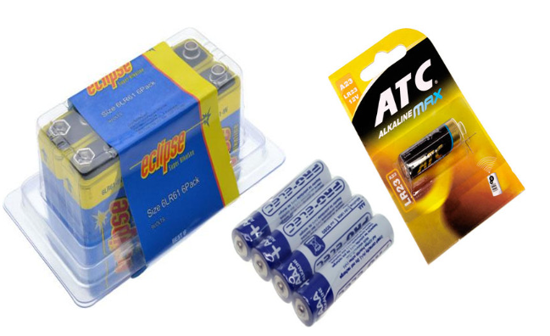
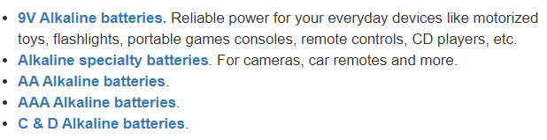
Alkaline batteries

Slide 9
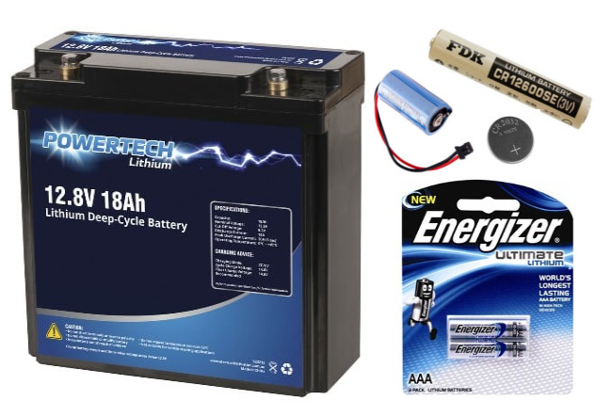
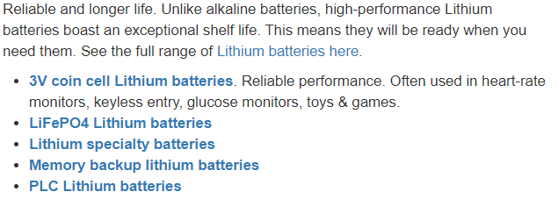
Lithium batteries

Slide 10
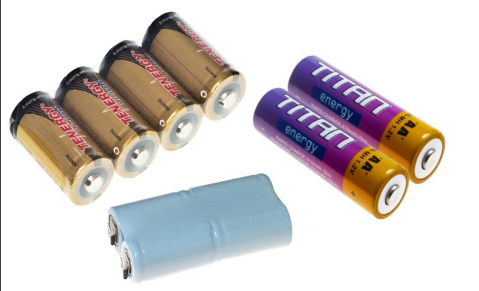
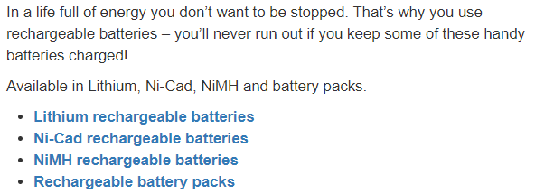
Rechargeable batteries

Slide 11
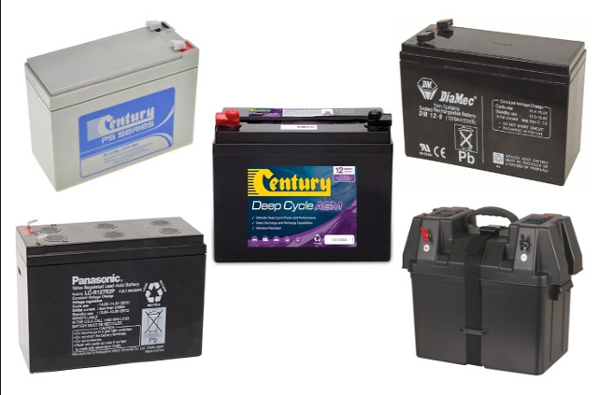
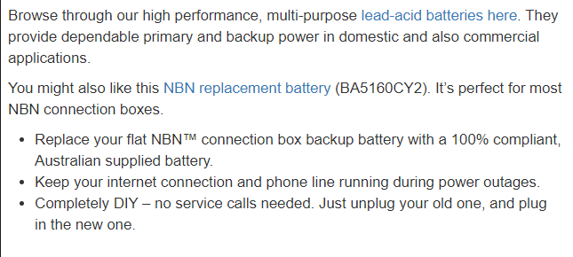
Second lead-acid batteries

Slide 12
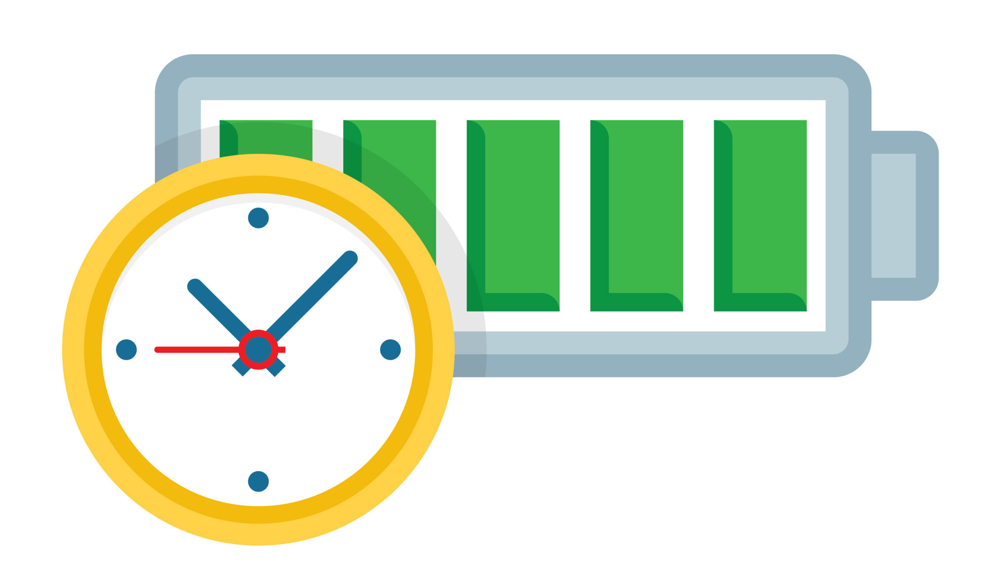
Battery Life
Battery life is a measure of battery performance and longevity, which can be quantified in several ways: as run time on a full charge, as estimated by a manufacturer in milliampere hours, or as the number of charge cycles until the end of useful life.
Build factors that affect battery life include the type, the number and the quality of cells used. Generally, battery health and longevity declines further into a battery's life and as a function of the number of charge cycles it has gone through. However, there are a number of things a user can do to extend battery life.

Slide 13
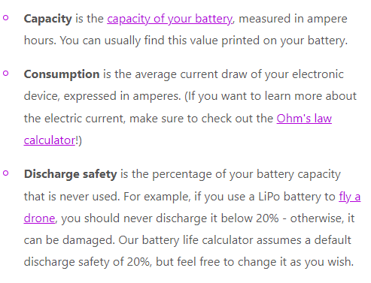
How to calculate battery runtime?
$$Battery Life=\frac{capacity}{consumption}(1−discharge safety)$$

Slide 14
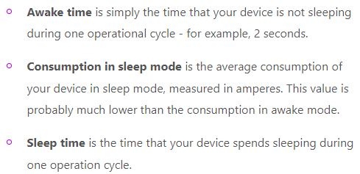
How long will a battery last : sleep mode?
$$Average consumption=\frac{(consumption 1 ×time 1)+(consumption 2×time 2)}{(time 1+time2)}$$

Slide 15
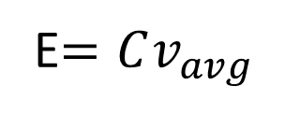

Calculation on how much battery capacity needed.
E$=Cv_{avg}$
$$Q=it$$
Q = Charge in coulombs
i = Current in amperes
t = Time in seconds
E = Energy stored in watt-hours
C = Capacity in amp-hours
V= Average voltage during discharge

Slide 16
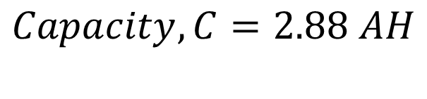
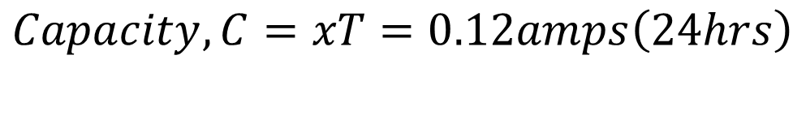
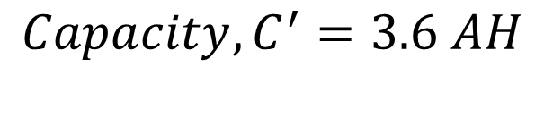
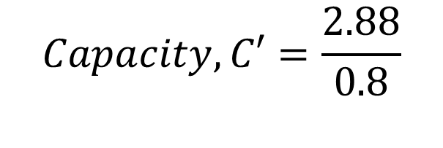
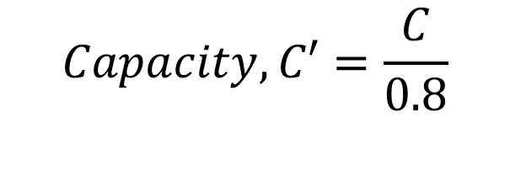
Example
Current drawn,x = 120mA
Running time,T = 24 hours
Cycle life consideration
Discharge safety = 20%
$$Capacity, C=xT=0.12amps\left(24hrs\right)$$
$$Capacity, C′=\frac{C}{0.8}$$
$$Capacity, C=2.88 AH$$
$$Capacity, C′=\frac{2.88}{0.8}$$
$$Capacity, C^{′}=3.6 AH$$
Thus, 3.6 amps hour battery is needed to run the equipment for 24 hours at 120mA current draw

Slide 17
Wireless Charging AGV
Wireless charging is a trending topic in the AGV and AMR industry. More and more Automated Guided Vehicle (AGV) suppliers are slowly incorporating this technology into their robots.
With an inductive wireless charging system AGVs and AMRs can perform contactless battery opportunity charging.
The system counts on a stationary active fixed coil on the floor on on a wall and on a mobile passive coil on the mobile robot.
The active coil generates a magnetic field that induces an alternated current in the mobile coil. This current is used to charge the mobile robot battery.

Slide 18
AGV Wireless Charging Manufacturers
B&PLUS
Daihen
Delta Energy Systems
In2Power
WiBotic
Wiferion

Slide 19
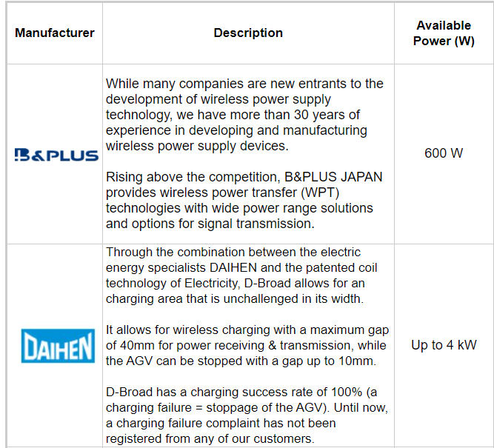
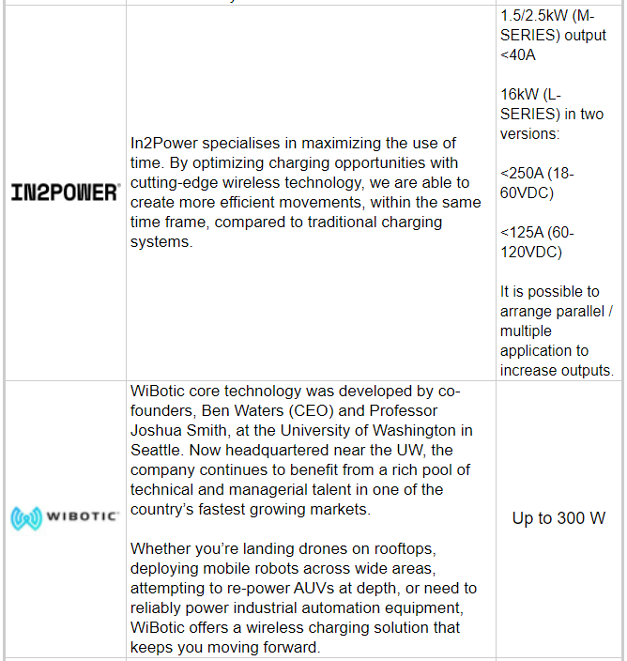
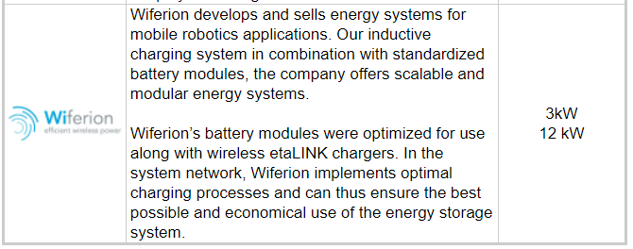

Slide 20
Mobile Robots Battery Charging Solution
Opportunity charging, for mobile robots, permits batteries to be charged several times during its working hours. The autonomous mobile robot or AGV goes to defined charging stations and performs charging while waiting for a new mission to be delivered. If the battery balance is properly calculated, the vehicle could never need a change of battery.
Battery swap strategy, the mobile robot works with a single battery until it is fully drained that need to be swapped with a fully charged one. Battery swapping can be done manually or automatically as needed or on a schedule.

Slide 21
How does Wireless Charging for AMR and AGV work?
As explained, the opportunity charging can be performed with the classical “contact charging” electrodes or with the latest “inductive contactless charging”.
In the “contact” charging there’s is a physical connection between the charging poles
In the “wireless” charging the power transfer is done without any physical contact

Slide 22
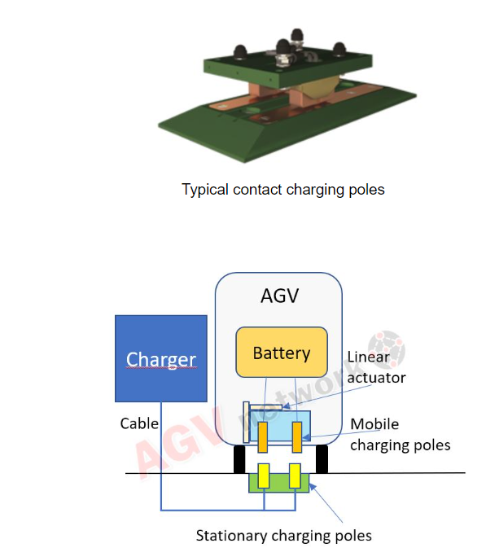
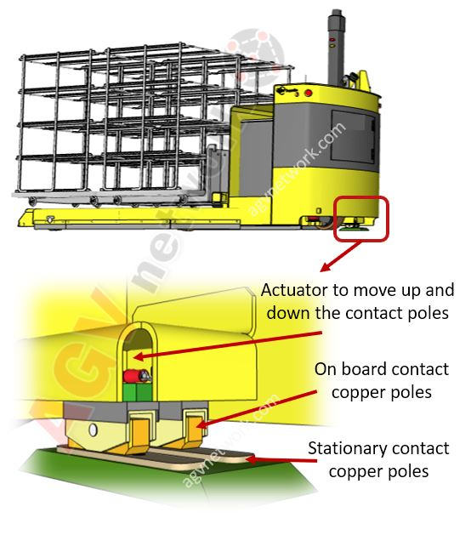
AGV and AMR contact charging system
The agv with the onboard charging poles arrives to the charging station. The charging station is composed by the stationary contact poles and the charger.

Slide 23
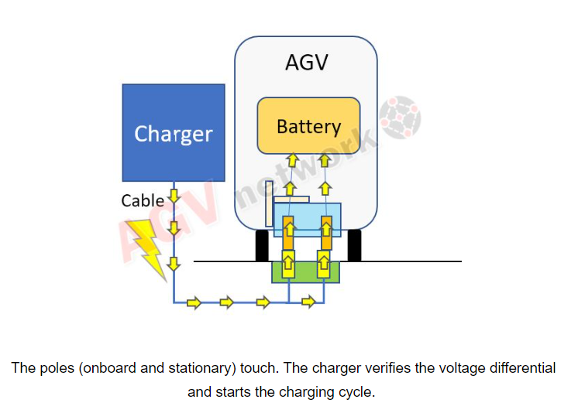
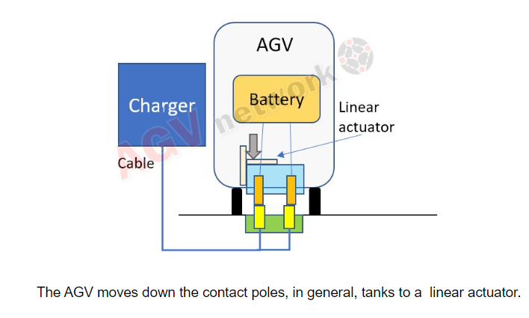

Slide 24
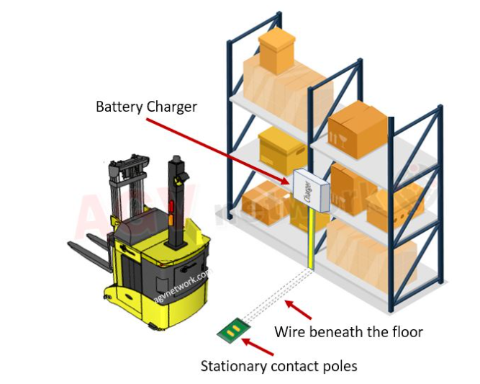

Slide 25
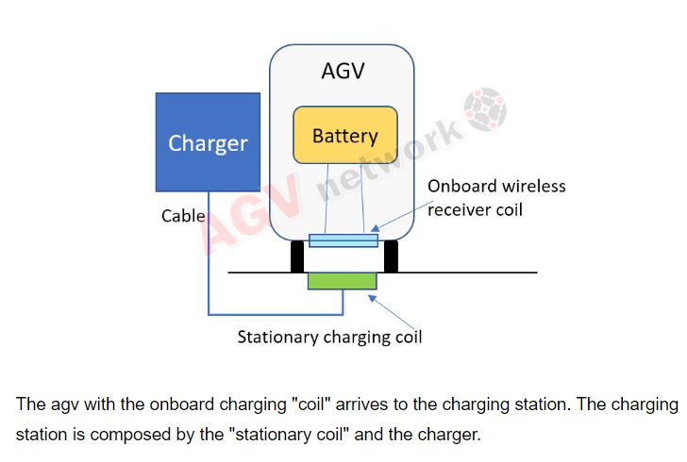
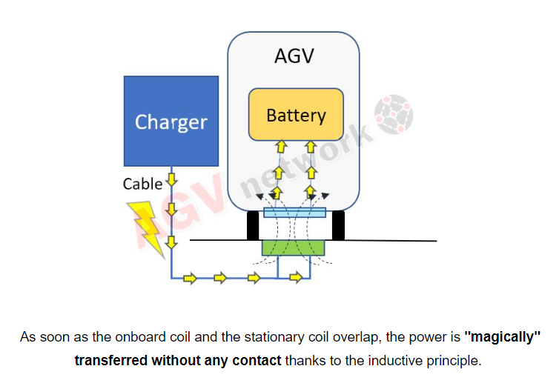
AGV and AMR wireless charging system

Slide 26
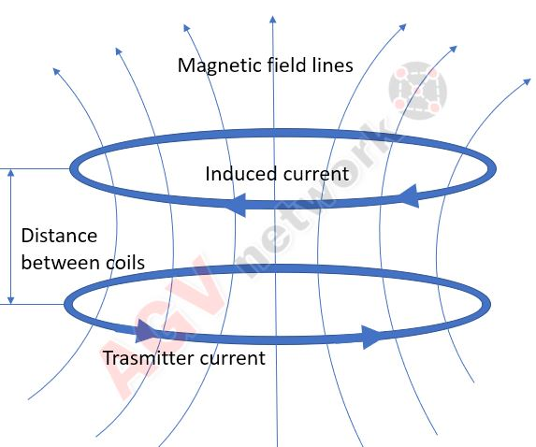
What is wireless inductive charging technology?
The concept of wireless charging is simple: a magnetic loop antenna (copper coil) is used to create an oscillating magnetic field, which can create a current in one or more receiver antennas (receiver coils).
The “induces” word opens the doors to the Inductive Power Transmission.

Slide 27
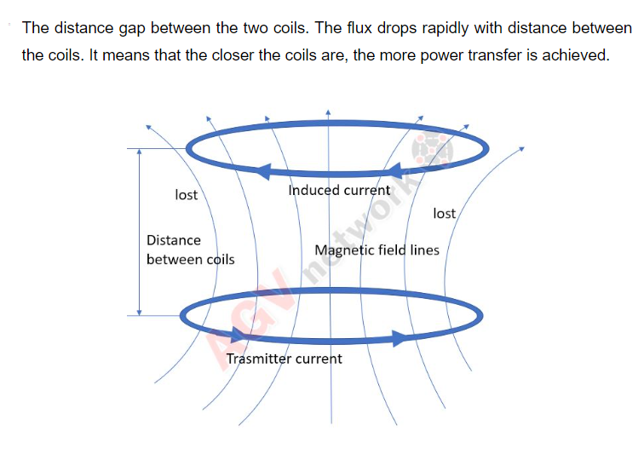
Consequently, the secondary coil must be placed as close as possible to the primary to intercept the most flux.
The amount of energy that the secondary coil captures is proportional to the cross section that faces the magnetic field. The cross section depends on:
The alignment (parallelism) of the two coils.

Slide 28
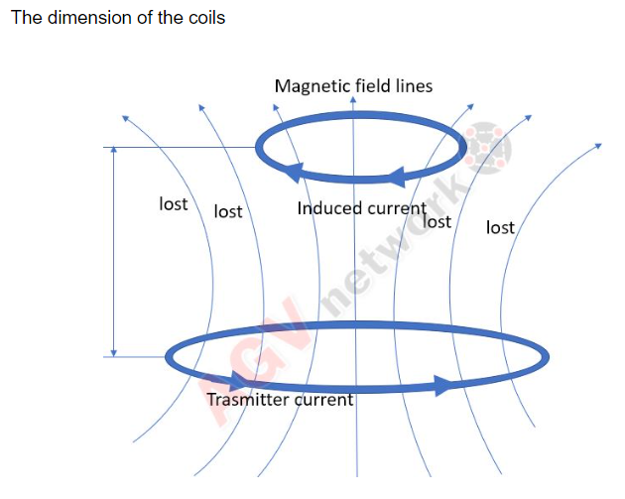
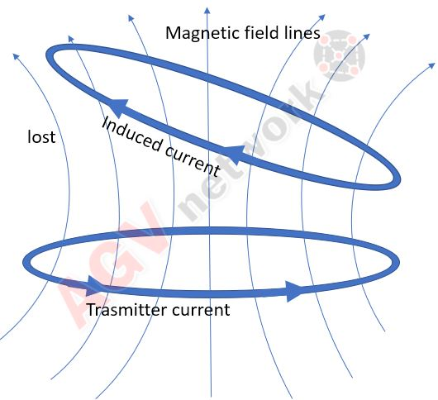

Slide 29
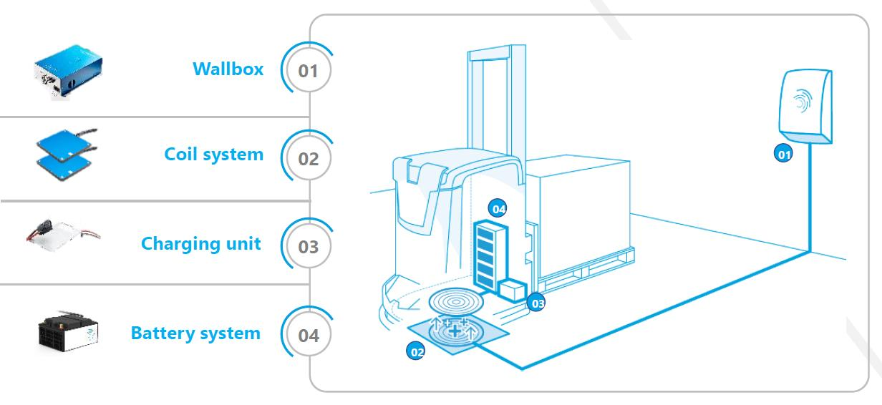
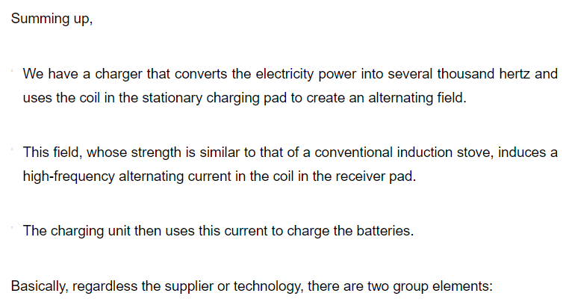
Autonomous Mobile Robots Wireless Charging Facts

Slide 30
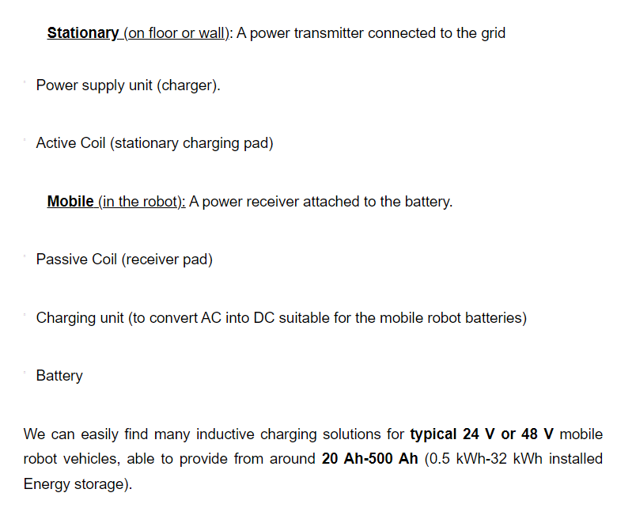

Slide 31
What about batteries? What batteries are suitable for inductive charging?
Inductive charging is compatible with all battery types.
Open Lead Acid Batteries
GEL/AGM Batteries
Pure Lead Batteries
Lithium Batteries

Slide 32
What are the advantages to Wireless Charging For AGV and AMR Robots?
The main benefits of contactless charging technology are:
High Efficiency 93%-95%
Full Power Of High-Energy Streams Immediately After Start
No Wear And Tear Or Maintenance As There Are No Contacts Involved
High Mobile Robot Positioning Tolerance Compared To Contacts And Omnidirectional Charging
One single wireless charging system can supply power to different vehicles and batteries
Intelligent data transfer during wireless charging

Slide 33
Full Power Of High-Energy Streams Immediately After Start
With the wireless systems, the battery starts to charge faster compared with contact charging solutions.
In the contact solution, we have a charging module installed in the mobile robot that must move while starting/finishing to charge. This operation is time consuming. Maybe only few seconds, but those seconds add up over time, and time = money.

Slide 34
High Mobile Robot Positioning Tolerance Compared To Contacts And Omnidirectional Charging
The contact charging poles must be in “contact”, so AGV positioning will depend on the shape and dimension of these poles (on board and on floor or wall).
Moreover, with the contact charging poles, your Automated Guided Vehicle will probably be required to arrive to the charging station from one single direction.
This feature is very interesting for Autonomous Mobile Robots (AMR), which do not follow a given path and can vary their trajectory depending on surrounding environment.

Slide 35
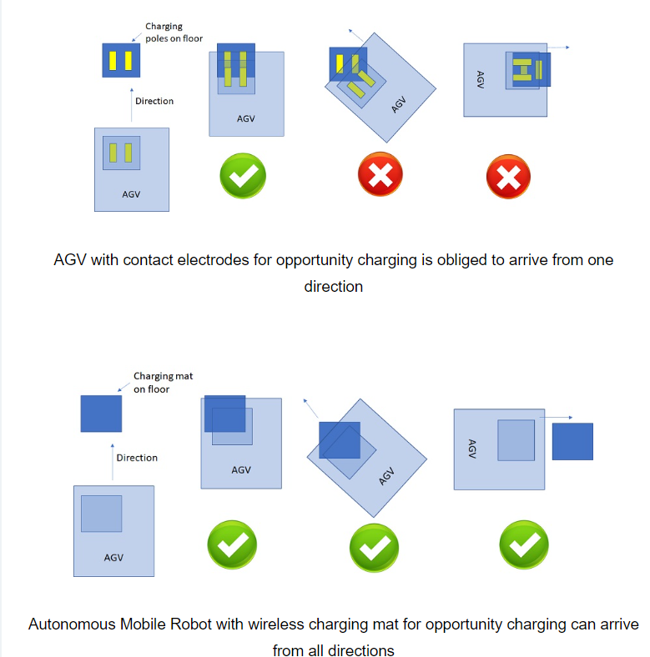

Slide 36
One single wireless charging system can supply power to different vehicles and batteries
One wireless charging system can provide different Voltages for different battery types.
This means you only need one charging system to charge different vehicles, for example an AGVs with a 48 V lithium-ion battery and an industrial truck with a 24 V lead-acid battery.
All vehicles can use the same charging pad and the system autonomous chooses the right power for the vehicle.

Slide 37
Intelligent data transfer during wireless charging
Some suppliers offer CAN connection allowing to transfer data during the charging process. All the relevant battery and vehicle data can be transferred into a cloud or directly to the AGV management system.
This feature helps to manage and monitor the AGV fleet together with advanced programming of predictive maintenance in order to optimize your logistic process.

Slide 38
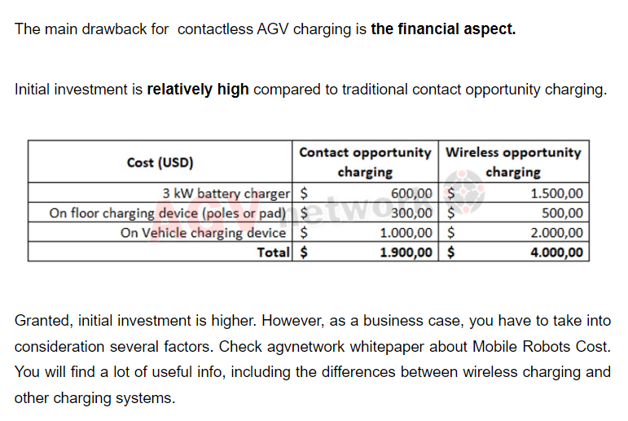
What Is The Main Disadvantage to Wireless Charging For AGVs And AMRs?

Slide 39
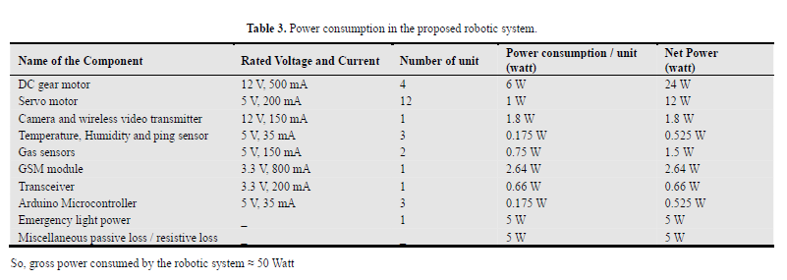
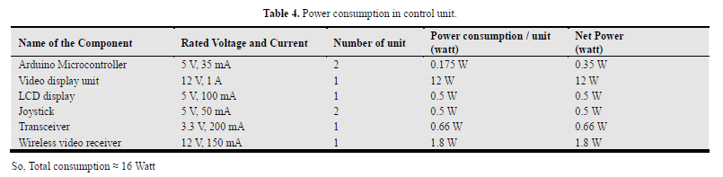
Power consumption for robotics system

